Slide 1
Intermediate Machine Learning
Zoë Wilkinson Saldaña, MSI
Arcus Education, DBHi

Slide 2

Welcome to Intermediate Machine Learning!
As you settle in, please write a question about machine learning you would like to answer today. (This can be anything!)
Our repository for today:
www.github.com/arcus/education-materials
Icons made by Freepik from www.flaticon.com

Slide 3
YOUR QUESTIONS!!!
Akkem + Remo: (No immediate need, but excited to learn and add to the toolset!)
Angelina + Vivek: Articles online discuss clinical data: How machine learning can help us to improve our work (in IS side)
Manoj + Ruchi: Audiogram-predicitive analytics
Matt + Kanchena: We want to train model, don’t have capacity, what do we do?
David: How do get buy-in from management

Slide 4
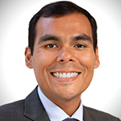



Welcome to Intermediate Machine Learning!
Zoë Wilkinson Saldaña, MSI
Data Instructional Specialist
Victor Ruiz, PhD
Data Scientist
Sheila Braun, MA
Data Instructional Specialist
Xueqin Pang, PhD
Data Scientist
Remo Williams, MS
Research Informatics Programmer

Slide 5

Hello!
Background: data science in academic libraries (Cornell University, University of Michigan)
Research interests: critical data science pedagogy; open source collaboration; reproducibility
Zoë Wilkinson Saldaña, MSI
Data Instructional Specialist
Arcus Education

Slide 6
Machine Learning with METACHOP
Introduction to Machine Learning
Machine Learning II / Topics in ML
https://github.com/arcus/education-materials/

Slide 7
Machine Learning with METACHOP
Our schedule for today:
Machine learning refresher with Zoë
Hands-on ML Pipeline with Victor
Statistics and ML with Sheila
Project time!
Research applications with Xueqin

Slide 8
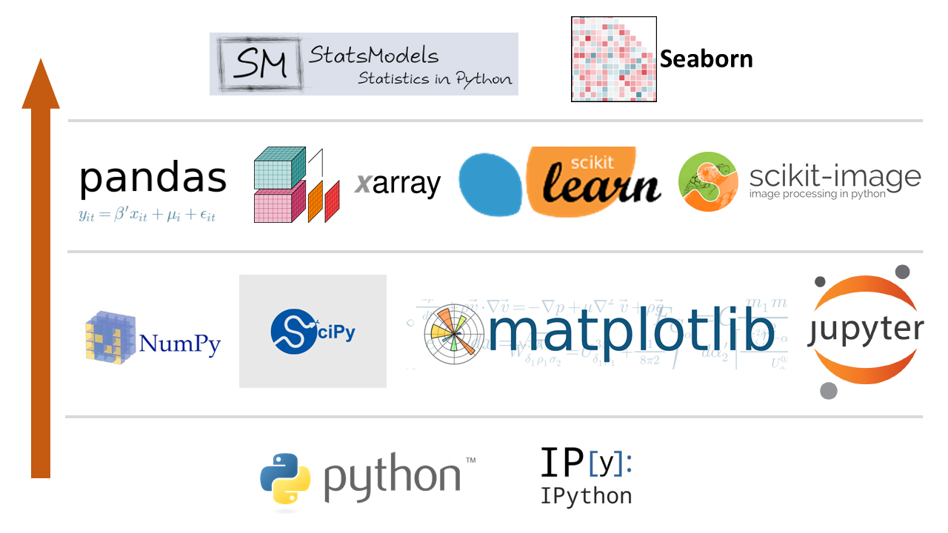
Data science in Python (the PyData stack)
http://chris35wills.github.io/courses/pydata_stack/

Slide 9

Data science in Python (the PyData stack)
http://chris35wills.github.io/courses/pydata_stack/

Slide 10
What is machine learning?

Slide 11
What is machine learning?
“The use of algorithms to identify patterns in data that help perform a task better.”
Data + learning a pattern + performing a task

Slide 12
Types of Machine Learning
Supervised
Unsupervised
Reinforcement

Slide 13
Supervised learning
(MI = myocardial infarction)
Data -> labeled training data
Task -> predict
Example: diagnosis (predict disease or no disease)
Deo, R. C. (2015). Machine learning in medicine. Circulation, 132(20), 1920-1930.

Slide 14
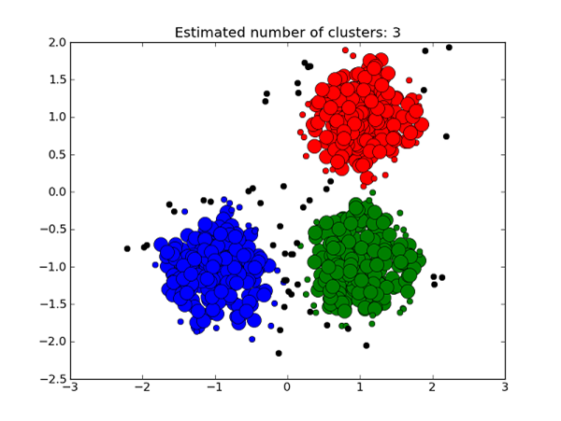
Unsupervised Learning
Data -> unlabeled data
Task -> assign to cluster; group features together to reduce dimensions
Example: cluster mRNA together based on similar patterns of gene activation
https://medium.com/deep-math-machine-learning-ai/different-types-of-machine-learning-and-their-types-34760b9128a2

Slide 15
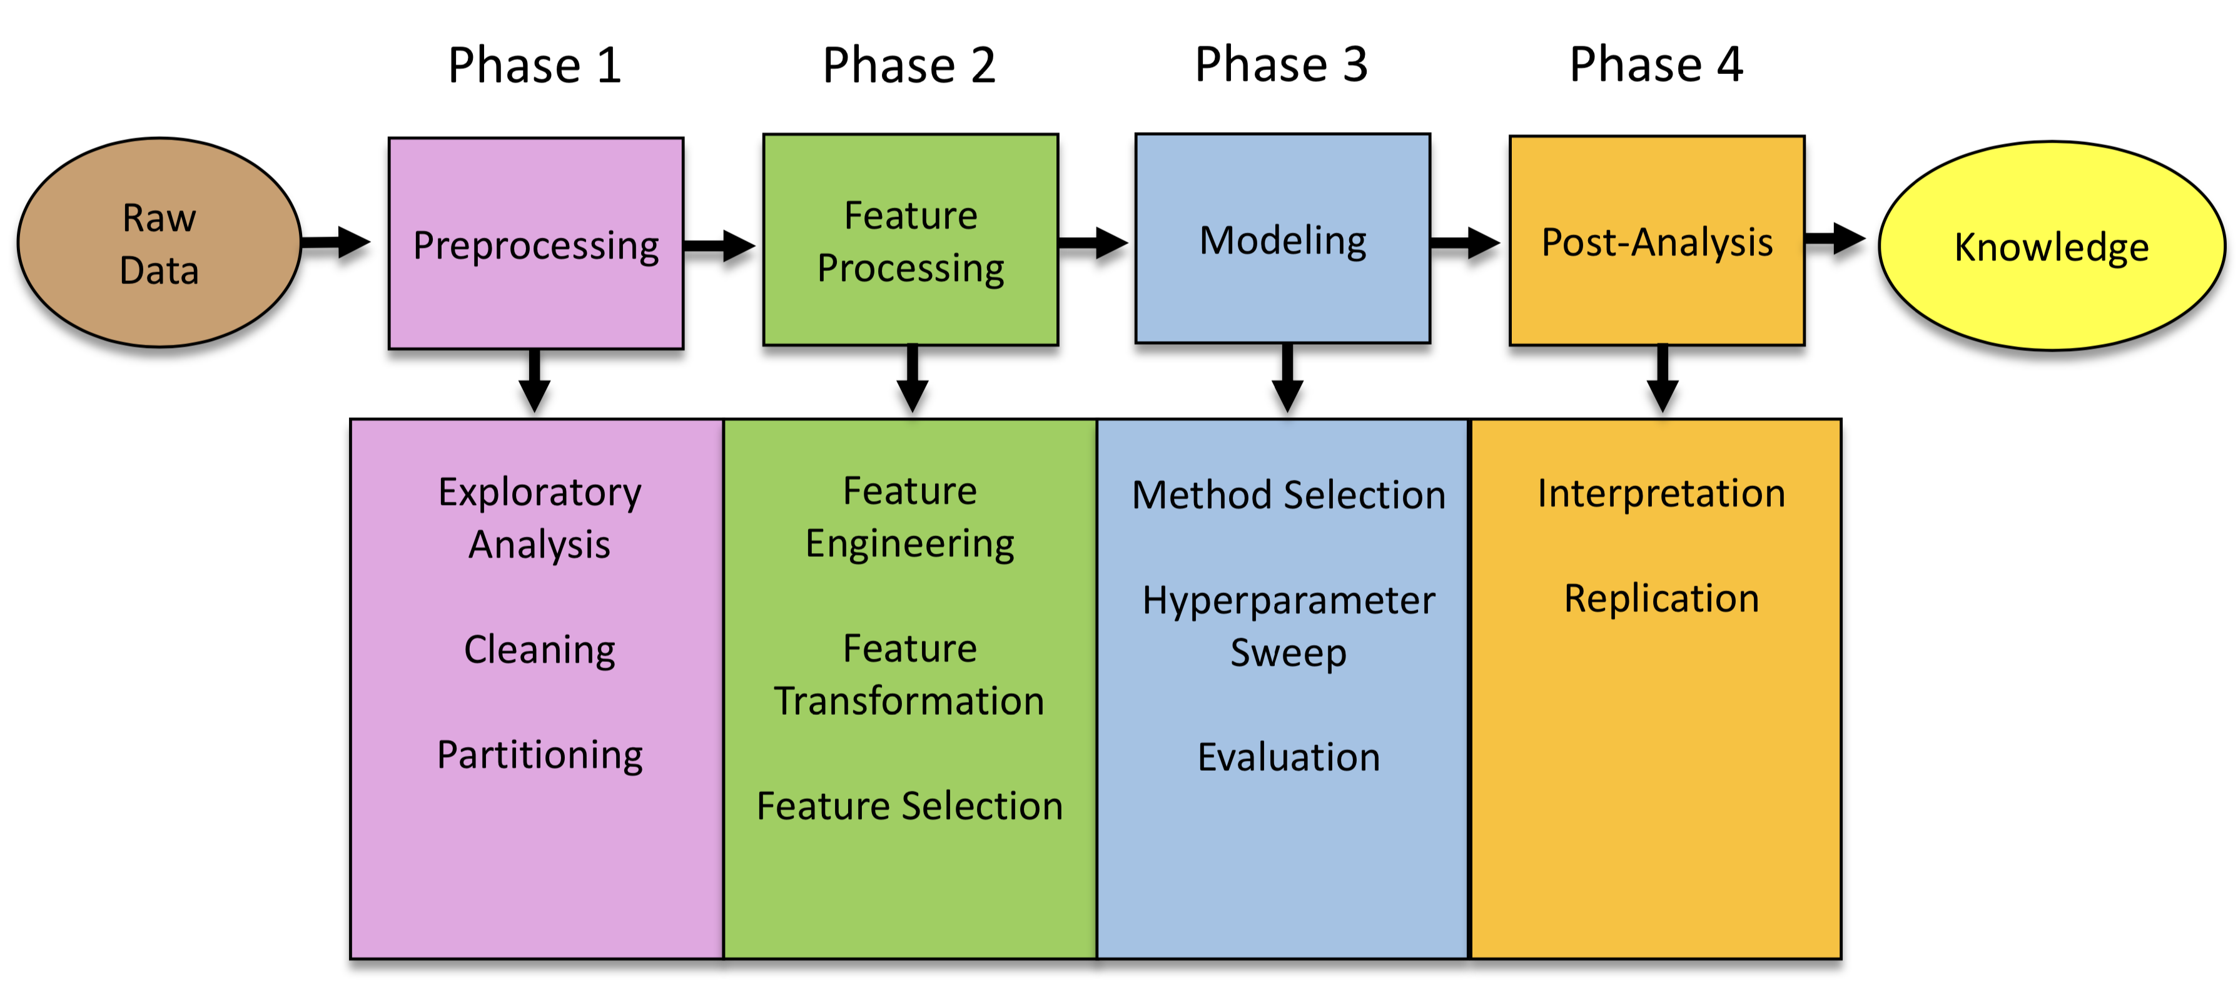
Machine learning pipeline
Urbanowicz, Ryan. 2019. https://github.com/UrbsLab/ML_Pipeline_Notebooks/

Slide 16
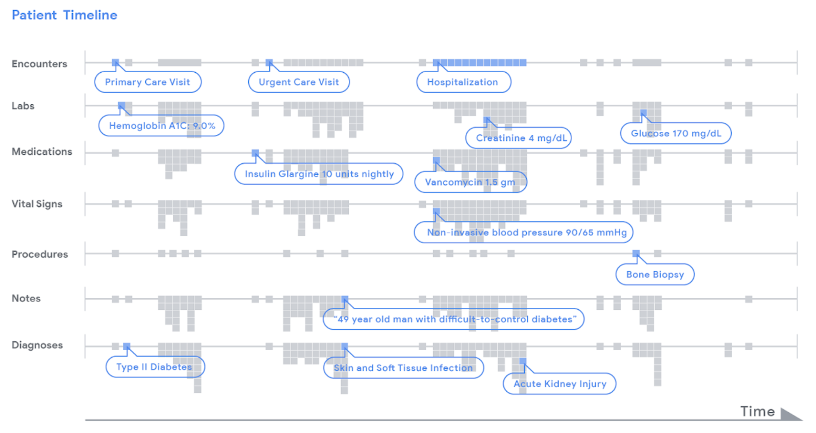
Features and targets
https://ai.googleblog.com/2018/05/deep-learning-for-electronic-health.html

Slide 17
Features and targets
(MI = myocardial infarction)
Features are variables you consider to make a prediction.
Usually a 2D array or matrix
Targets are the outcome variables we try to predict.
Usually a 1D array
Deo, R. C. (2015). Machine learning in medicine. Circulation, 132(20), 1920-1930.

Slide 18



Learning the function (the MODEL)
Deo, R. C. (2015). Machine learning in medicine. Circulation, 132(20), 1920-1930.

Slide 19
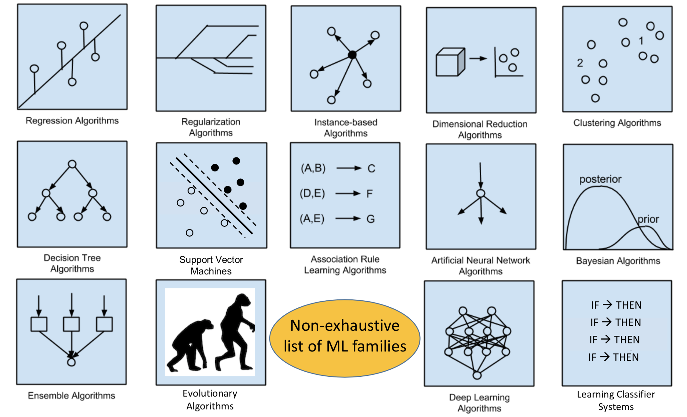
No free lunch theorem
Urbanowicz, Ryan. 2019. https://github.com/UrbsLab/ML_Pipeline_Notebooks/

Slide 20
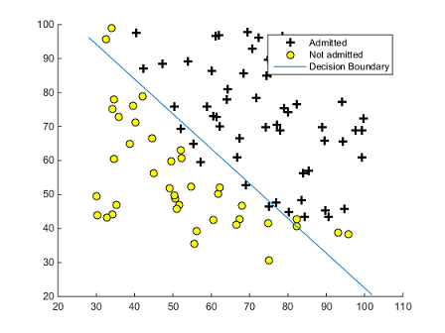
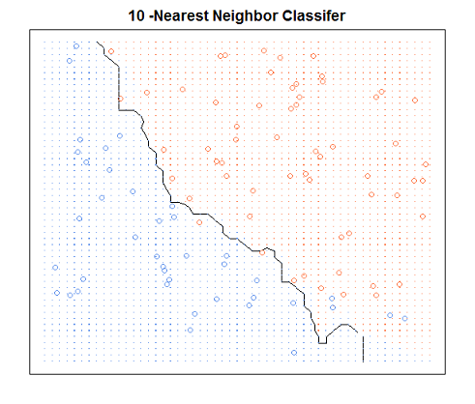
Decision boundary: logistic regression vs k-NN
https://qqdaiyu55.github.io/2016/02/11/plot-classification-decision-boundary/

Slide 21
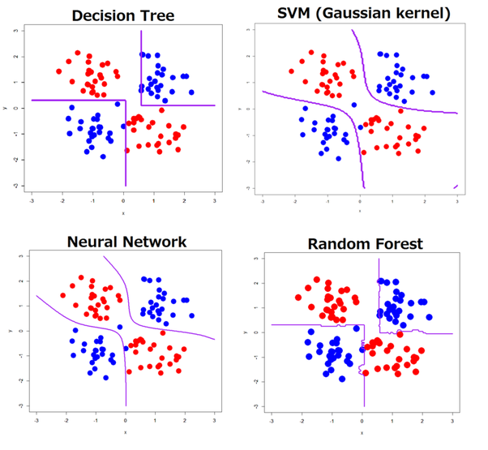
More decision boundaries
https://www.kdnuggets.com/2015/06/decision-boundaries-deep-learning-machine-learning-classifiers.html

Slide 22
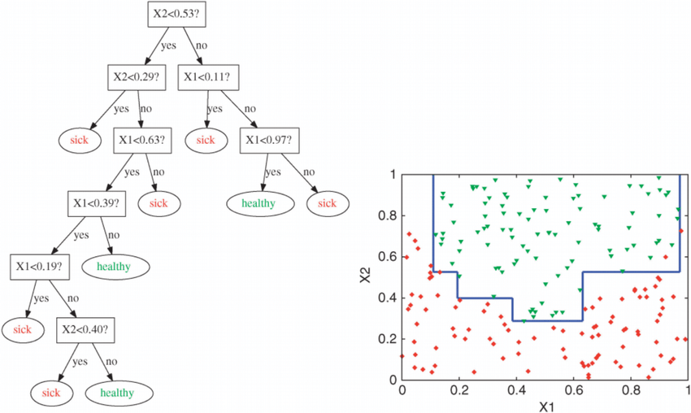
Decision trees

Slide 23
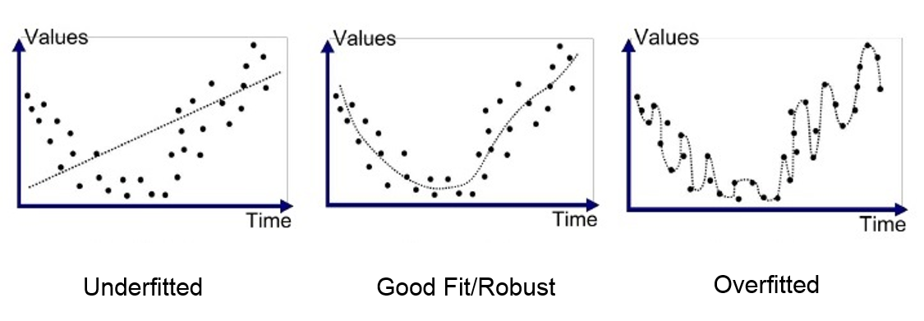
Model fit
https://towardsdatascience.com/regression-or-classification-linear-or-logistic-f093e8757b9c

Slide 24
The ML pipeline

Slide 25
Notebook!

Slide 26
Parameters vs hyperparameters
Parameters: Weights, rules, and other learned elements that algorithm uses to assign output class.
Hyperparameters: Settings that determine how the learning algorithm functions. Can be modified or “tuned” for optimal performance.

Slide 27
Metrics of performance
Accuracy: True positive + True negative / All cases
Precision: True positive / True positive + False positives
Recall: True positives / True positives + False negatives
How do these relate to Type I and Type II error?

Slide 28
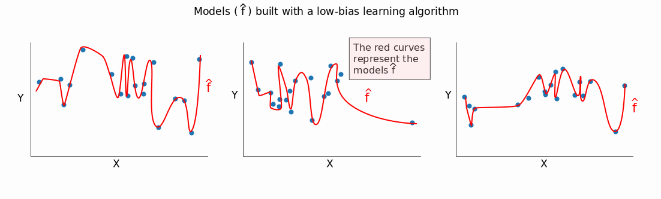
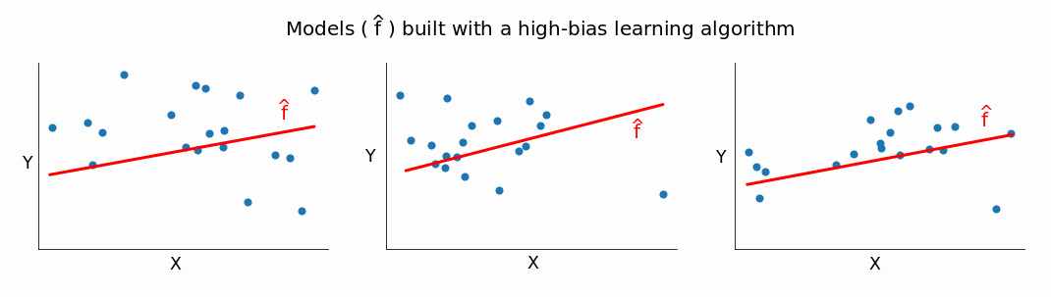
Metrics of performance
Bias
Variance
https://www.dataquest.io/blog/learning-curves-machine-learning/

Slide 29
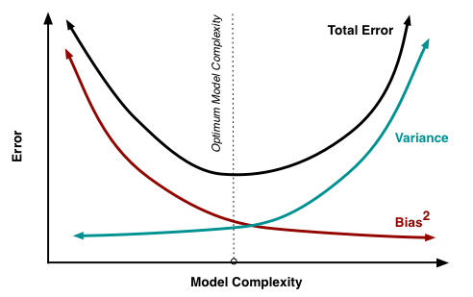
Metrics of performance
Bias
Variance
https://www.dataquest.io/blog/learning-curves-machine-learning/

Slide 30
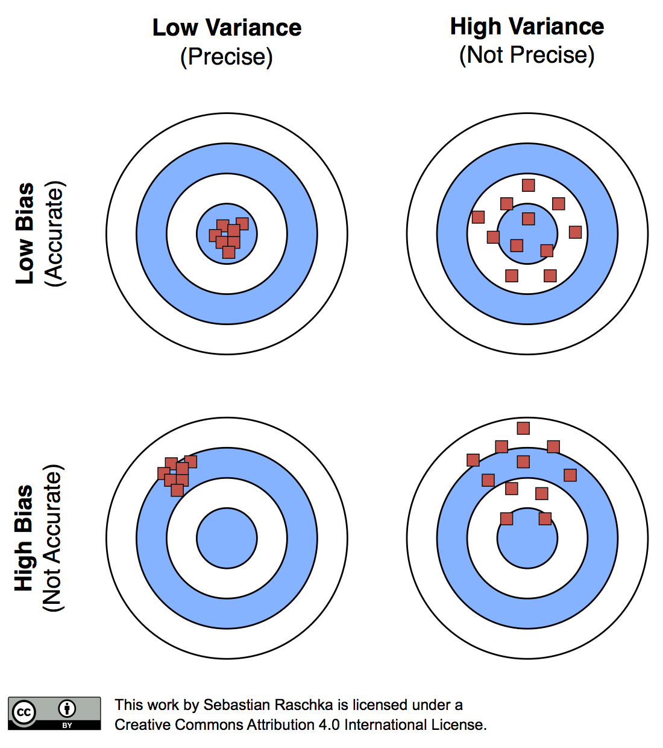
Metrics of performance
Bias
Variance

Slide 31
Turn to your neighbors
What types of tasks are a good fit for machine learning?
What are some of the difficulties of applying machine learning in your domain of expertise?
Where do you think bias (in the broader sense) may impact machine learning?
Icons made by Freepik from www.flaticon.com

Slide 32
Identifying Medical Diagnoses and Treatable Diseases by Image-Based Deep Learning
https://www.sciencedirect.com/science/article/pii/S0092867418301545?via%3Dihub
https://www.youtube.com/watch?v=EuBBz3bI-aA

